Slide 1

DYNAMIC PROXY
Presented by Mohammad Nasr

Slide 2
Proxy design pattern
Design pattern
Design pattern are general reusable solution for common problem that we encountered in software design and development .
Those are classify to 3 type :
Creational : intent of those pattern is how object created . Design pattern in this category are :
Singleton . Factory . Builder . Prototype
Structural : intent of those pattern is composition of class and object and forming larger structure . Design pattern in this category are :
Adapter . Decorator . Composite . Proxy . Bridge . Façade
Behavioral : intent of those pattern is communicate with each other . Design pattern in this category are :
Observer . Strategy . Command . Iterator . Chain Of Responsibility ….
We want to cover Proxy Structural Design pattern as prerequisite of our topic
Proxy design pattern is structural design pattern that let you provide placeholder for another object . Proxy class allow perform something before or
either after request goes to original request

Slide 3
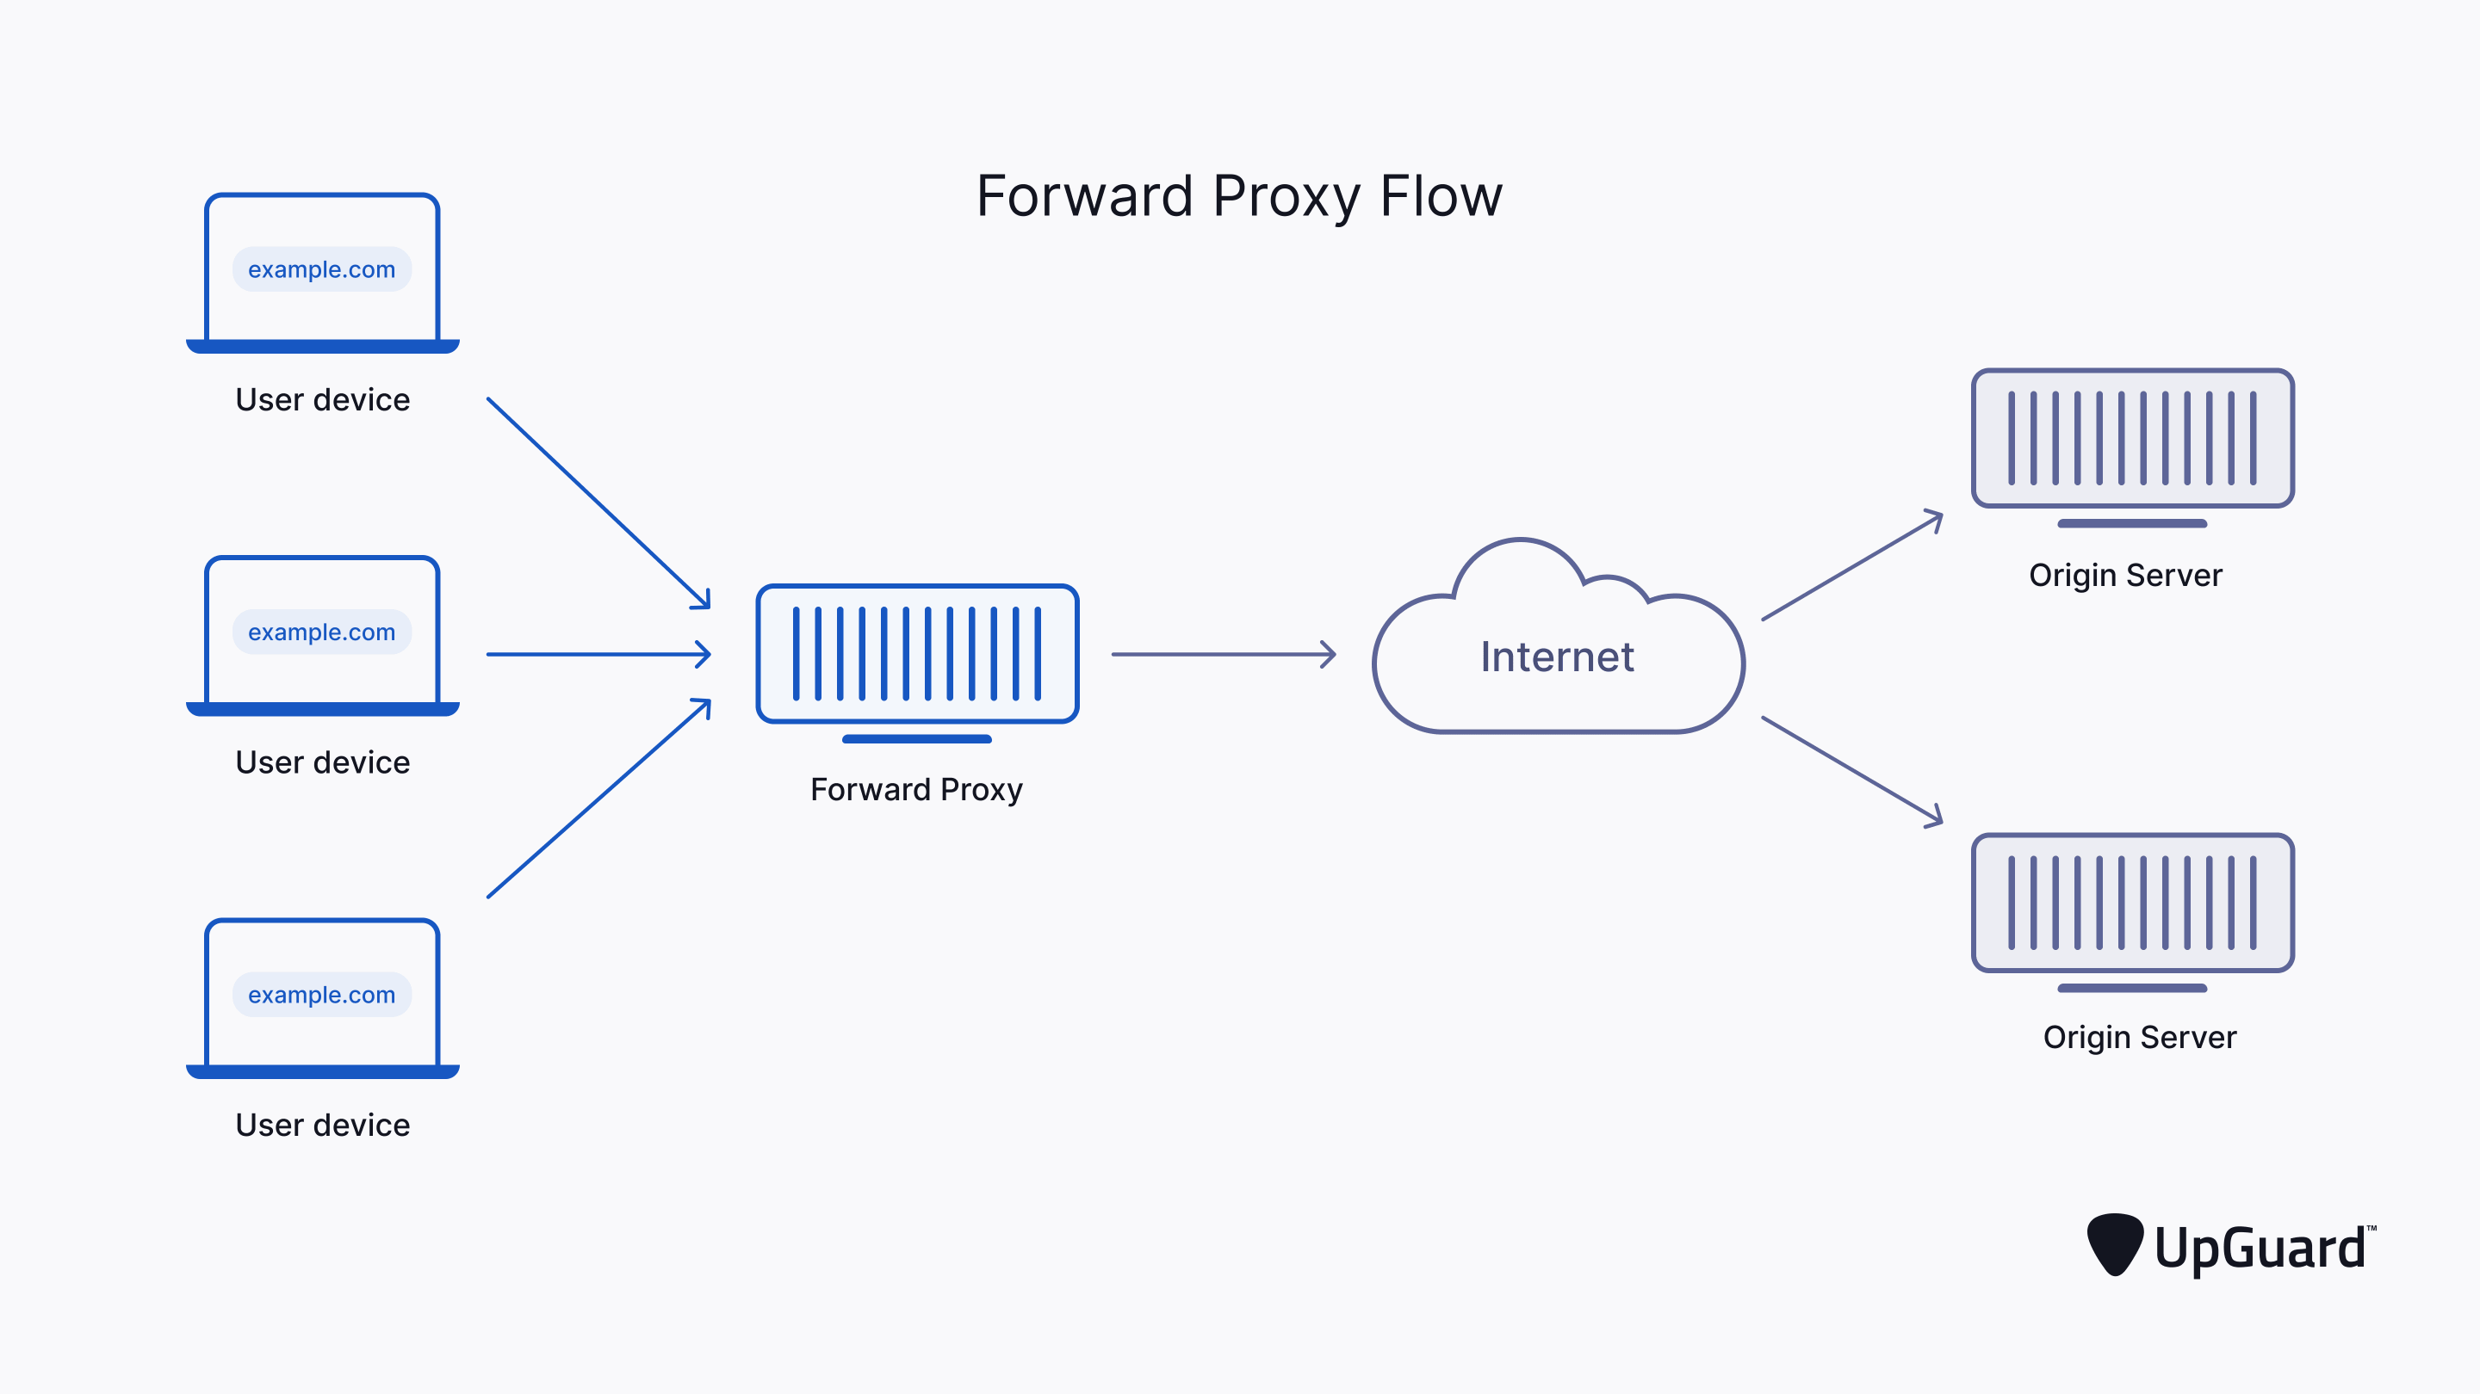
Proxy design pattern intent according to GoF is: Provide a surrogate or placeholder for another object to control access to it if you want to use class is fine but we want to give access them to client application . That need to had some capability or restriction or track before request processed and so on let see real world sample that let you comprehension better as you know lot of us wee using proxy for access to telegram or proxy server that it middleware between client and internet

Slide 4
why we need proxy instead of direct access 1. privacy : proxy can be used to hide user ip address . This is important for who want to access to internet revealing their true identity or location 2. security : proxy can act as additional layer that filter malicious content such as malware , virus , phishing . It can restrict access to content of specific website 3. access control : proxy allow organization for monitor every activity 4. Geographical Access : can be used to access region restricted content . By route internet traffic through proxy server located on different region for example suppose you want to access to youtube.com but as policy of this company restricted ip originated from iran but not other country on Europe such as Italy then by using proxy server we connect proxy server located on Italy and proxy server responsible for route request to youtube.com also result redirected from proxy server to our pc and see result 5. network Performance Optimization : it can compress data and optimize content for faster delivery

Slide 5
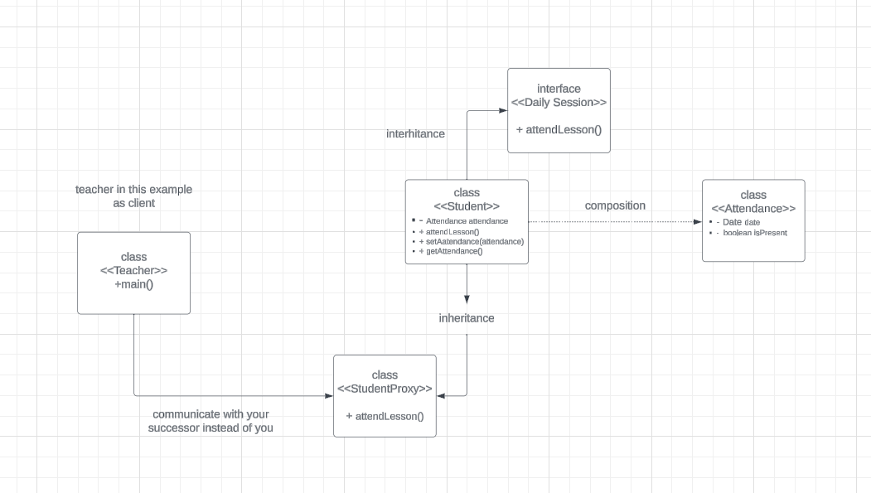
consider scenario that you had problem and cant to attend to online class but you say to your friend to be attend at class on behalf of you . That whenever teacher (as client) ask question Mr Hoseini your you don’t attended to class but your friend says present on chat box section .

Slide 6
Lets go to practical example for previous slide and better understanding proxy topic

Slide 7
what’s reflection and why we learned this as prerequisite for learn JDK proxy let also for learn better dynamic proxy and JDK proxy lets a little deep dive into reflection in java reflection is capability that we can modify inspect runtime attribute of class , interface, property and methods . Primary intent of reflection is obtain information about class and its member and dynamically interact with them. It enable following capability listed below : inspect class information : you can obtain information about classes , interface , method , constructor at runtime it can be useful for task for framework work with classes in flexible and dynamic way instantiate class dynamically : allow create instance of class at runtime even you don’t know class name until runtime (JDK proxy use these feature create instance of proxy class at runtime access and modify fields : you can access and modify property even private one at runtime invoke method Dynamically : reflection allow you to invoke method on object dynamically . This is useful when you want to call method base on user input important note : reflection is powerful feature but also we need to use it more precise because if you had wrong it occurred at runtime and able to interrupt program . Also it lead less type safe code , ignore encapsulation . We recommend you don’t use as much as possible . But also my need to used it for write library where structure of class is not known until runtime.

Slide 8
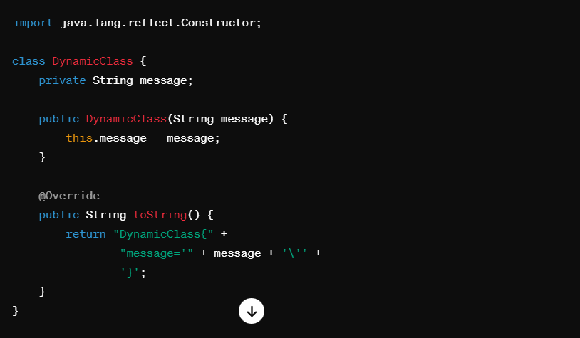
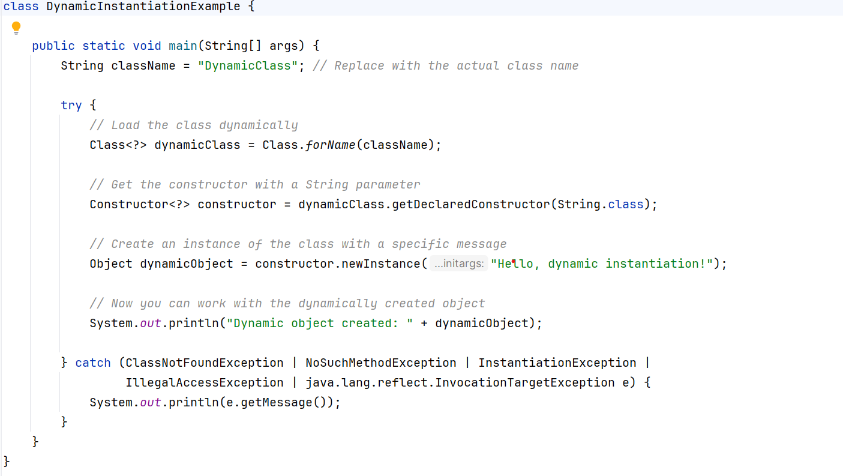
Let see simple code that we load class with class loader and create instance from that using constructor of it at this time we had concept of proxy design pattern and overview of reflection at this time we are able to comprehense how dynamic proxy work

Slide 9
What is dynamic proxy ? What are different type ?How transactional work behind scene? Dynamic proxy in java is mechanism that allow you to create proxy instance for interface at runtime Dynamic proxy type divided in 2 type JDK proxy and CGLIB proxy dynamic proxy are commonly used in Aop (aspect oriented programming ) we want to separate our concern from business logic such as cache , security , log , transaction lets overview some key term of Aop: Aspect : is module that encapsulate a cross cutting concern . It define what need to be done( as action or advice) and where it should be applied join point : is a specific point of program . It can be method call point cut : it define the condition under which advice should be executed . Point cut use expression to match join point advice : actual code that need to be executed at join point . There are different type exists such as (before – after – around …) weaving : is process of integrating aspect with main application code . It can done on different stage. Compile time , load time , run time . JDK weaving at runtime lets see simple java code use this concept

Slide 10
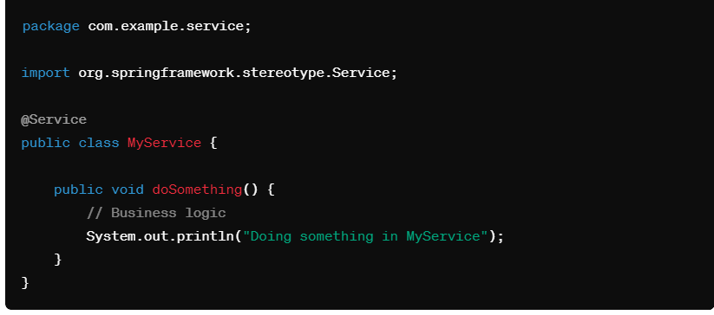
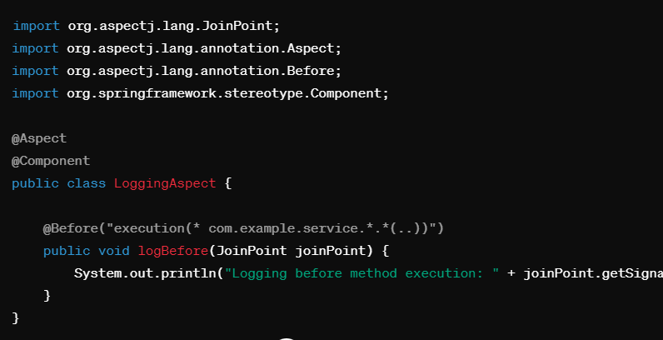

Slide 11
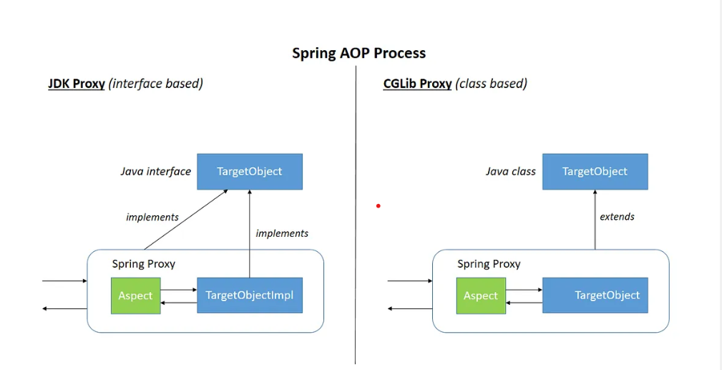
JDK Proxy
JDK Proxy is type of dynamic proxy that works only with interface . And proxy generated at runtime base on interface . We called dynamic proxy because work without knowing at compile time the type to be proxied

Slide 12
JDK Proxy comes with JDK and does not need any external library
Lets go to step need to use JDK proxy
Interface definition : You start with an interface that defines the methods to be proxied. In the case of dynamic proxies, this interface must be known at compile time
2. Invocation handler implementation : You create a class that implements the InvocationHandler interface. This class is responsible for handling method invocations on the proxy.
3. Proxy class generation : When you call Proxy.newProxyInstance(...), the Java Virtual Machine (JVM) generates a proxy class on-the-fly. This class is created in memory and is not saved to the filesystem.
4. Bytecode generation : The proxy class is generated dynamically using bytecode generation libraries like ASM (Abstract Syntax Tree-based bytecode manipulation) or Byte Buddy. These libraries allow you to define the structure of the class, methods, and fields programmatically
5. Class loader : The generated bytecode is loaded into the JVM using a class loader. The class loader is responsible for defining and loading the classes during runtime.
6. Proxy class initialization : the proxy class is initialized, and an instance of it is created. This instance implements the interface specified during proxy creation and delegates method invocations to the InvocationHandler.
InvocationHandler Invocation:

Slide 13
Lets go to practical example for understand better concept of JDK proxy

Slide 14
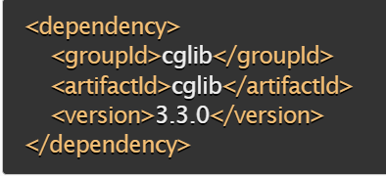
CGLIB
CGLIB as byte code generation library offer dynamic proxy capability. By understanding this feature you gain into advance programming technique that important for modern software development.
Cglib is high performance java library crucial for byte code generation and dynamic proxy creation .unlike jdk proxy cglib allow to proxy concrete class without need to implement base interface . This capability useful in spring boot while you define bean as server annotation at concrete class without need to implement interface .
You can intercept method . And put additional logic such as log , security , cache , validation and so on .
Note you add those capability without modifying original code for different reason source code provided as library and you had read only access to code
For work with CGLIB you need to add bellow dependency to your project that correspond to your build tool
If you are maven add following dependency to your pom.xml

Slide 15
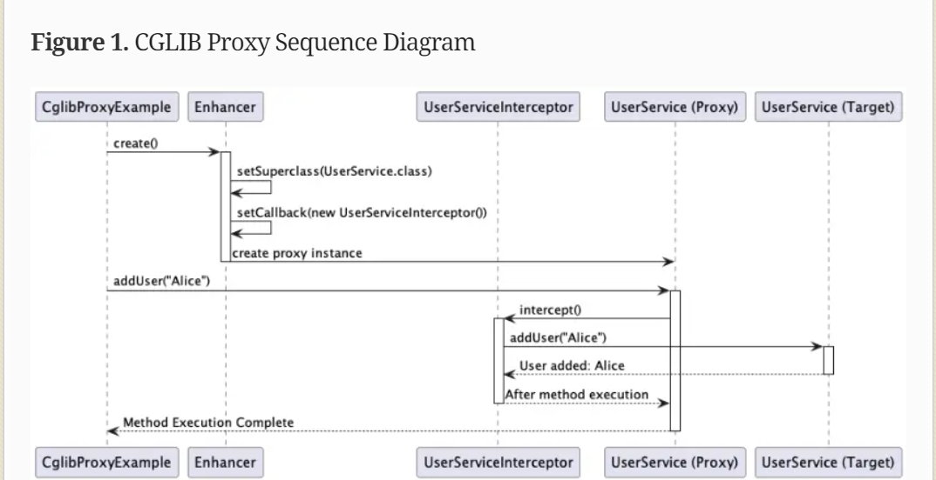
Above picture related to CGLIB proxy sequence diagram

Slide 16
how CGLIB work ?
We want to explore some key terminology of CGLIB
Enhancer : CGLIB operates by enhancing classes at the bytecode level. It generates a subclass of a given class (or interface) and overrides or adds methods to the subclass
Dynamic Class Generation : CGLIB dynamically generate a new class during runtime that extend target class or implement target interface
Method Interception : it allow to add interception get invoked when method of enhanced class ( proxy class)
called . It can be used to modify behavior or modify parameter or every logic you want
to added.
4. No Interface Requirement : unlike JDK proxy can proxy both class and interface .

Slide 17
Lets go to practical example for understand better concept of CGLIB Proxy

Slide 18
Overview of Pros and Cons & Comparison between JDK & CGLIB
JDK Pros :
Dynamic Behavior : allow create proxy instance dynamically at runtime , provide flexibility and adapt new requirement without changing code structure it cause open close solid principle ( if we modify legacy code violate solid principle but we use dynamic proxy we don’t violate this principle .
Interface base : JDK Proxy work only with interface . It cause cleaner design and use code to interface and
Open close principle
3. Simplicity : create dynamic proxy using Proxy class in jdk is straightforward and less boilerplate code .
4. Standard library support : it as part of standard library and you don’t need to add additional dependency

Slide 19
Overview of Pros and Cons & Comparison between JDK & CGLIB
JDK Cons :
Its interface base . It can be proxy as interface . If you want to use proxy for class you need to use CGLIB
Runtime overhead: there can be some runtime overhead associated with dynamic proxy when compared to static proxy or direct call
3. Simplicity : create dynamic proxy using Proxy class in jdk is straightforward and less boilerplate code .
4 limited control : provide less control over proxy creation process compared to other mechanism . For some use case you need to consider alternative solution
5. Final method : it can not proxy final method . Because it cant to override that

Slide 20
Overview of Pros and Cons & Comparison between JDK & CGLIB
CGLIB Pros :
It support interface as well as class : you can proxy for class not just interface this feature give you flexibility
for other class designed already
Performance : it give better performance in some case when proxy class with large number of method
3. additional feature : provide additional feature like method interception , method chaining and more.

Slide 21
Overview of Pros and Cons & Comparison between JDK & CGLIB
CGLIB Cons :
Debugging complexity : debug dynamically generated classes by CGLIB is more complex than standard class
because it manipulate byte code
Memory usage : it use more memory usage by generation class at runtime
3. Library dependency : CGLIB is a third party library so you need to include it as dependency to project.
4 Complexity : Generating bytecode and working with low-level details of class manipulation can be more complex than using JDK dynamic proxies
5. Compatibility : CGLIB might have issues with certain frameworks and tools that perform static analysis or bytecode modification, as it involves bytecode manipulation during runtime.(for example it want to modify java.lang package and for java version above 9
6. Maintenance : CGLIB-generated proxies are tied to specific versions of the library and may require updates if there are changes in the library or if you upgrade other dependencies in your project.

Slide 22
Thanks for your attention
if you had any question and problem
you able to contact me at this Address

